Slide 1

••Facebook Ads Campaign Marketing Data.
•Facebook Marketing Ads Campaign Performance
DATA TYPE: Facebook Ads Campaign Marketing Data
REPORTING CYCLE: 4th Quarter Report (October to December 2023)
PRESENTED BY:
GROUP 1 DABI FEBRUARY_2025 INTERNSHIP PROJECT

Slide 2
GROUP NAME AND TEAM MEMBERS
Samuel Kwadwo Boateng Bonsu.

Slide 3
KEY PERFORMANCE INDICATORS.
1. Compare number of campaigns in all countries.
2. Average number of campaigns per country on monthly basis.
3. Compare campaigns that were active, delivering, not delivering and completed.
4. Amount spent per month on campaigns and leads generated in all countries
5. Determine the Cost Per Result (CPR) for question (4) above by countries.

Slide 4
BENCH MARKS.
1.Monthly Campaign Budget
•UK = $3,000
•USA & CA = $1,000
•NG, GH and Other African Countries = $500
2.Cost Per Result Per Country
•United Kingdom $5/ Result ($700/ week)
•USA $5/ Result ($130/ week)
•Canada $5/ Result ($130/ week)
•Nigeria $0.30/ Result ($105/ week)
•Ghana $0.30
•Other African Countries $0.30/Result ($35/ week) (Ghana, Rwanda, Uganda, South Africa)

Slide 5
TERMINOLOGIES
Campaign Delivery: The status of the campaign (e.g., active, completed, inactive, not delivering).
Results: The number of results generated by the campaign (e.g., leads, conversions, clicks).
Reach: The number of unique people who saw the ad.
Amount spent (USD): The total amount spent on the campaign in USD.
Ad Set Budget: The budget allocated to the ad set.
Result Indicator: The type of result (e.g., actions:onsite_conversion.lead_grouped, link_click). Used to filter or group results by type.
Impressions: The number of times the ad was shown. Used to analyze ad performance.
Cost per Results (CPR): The cost per result (e.g., cost per lead, cost per click). Used to measure campaign efficiency and compare it to benchmarks.

Slide 6
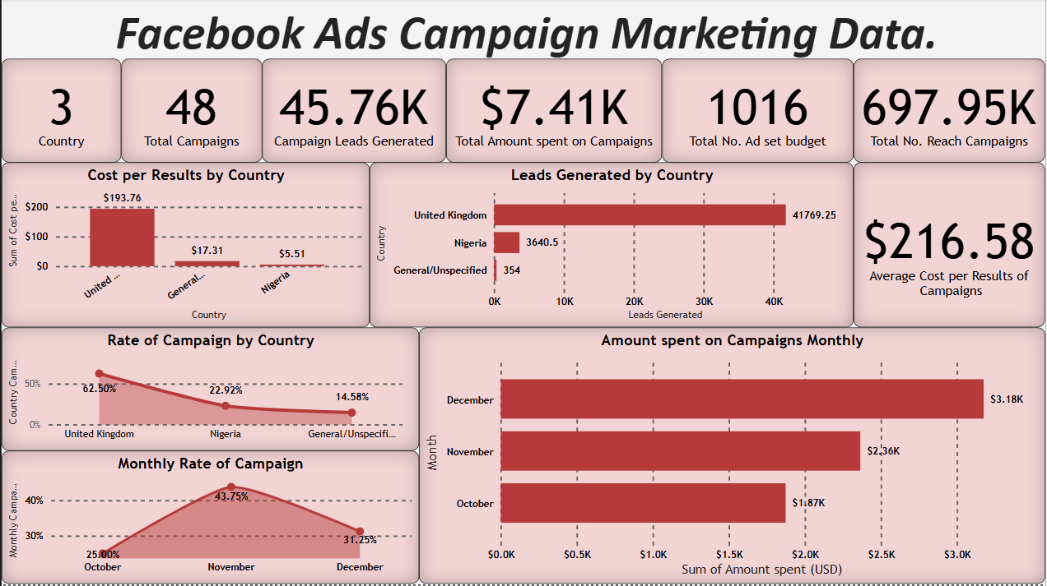

Slide 7
KPI 1: Number of Campaign by Country.
SUMMARY REPORT
The total number of campaigns is 48. With United Kingdom having 30 campaigns, Nigeria having 12 campaigns and General/Unspecified countries having 7 campaigns.
This graph show the number of campaigns by country. United Kingdom has 62.50% of the total number of campaigns. Nigeria has 22.92% of the total number of campaigns. And General/Unspecified countries have 7% of the total number of campaigns.

Slide 8
KPI 2: Average Number of Campaigns by Country on Monthly basis.
SUMMARY REPORT
With United Kingdom, the benchmark for the budget was $3000 /month was not achieved however in December it was close to the bench mark, $2919.90 which is 97% close to the benchmark.
In Nigeria, all the months had their total amount below the budget which is 44%, 55% and 32%(respectively) close to the benchmark.
And for General/Unspecified countries, they had their total amount below the budget as well.

Slide 9
KPI 3: Comparing Campaigns that are active, not delivering, delivering and completed.
SUMMARY REPORT
In United Kingdom, 46.67% of the ads were inactive, 36.67% of the ads were completed, 3.33% of the ads were not_delivering and 13.33% of the ads were active.
In Nigeria, 27.27% of the ads were inactive, 63.63% of the ads were completed, non of the ads were not delivered and 9.09% of the ads were active.
Lastly in General/Unspecified (i.e,. Countries like Ghana, USA, Kenya, and other countries), 28.57% of the ads were inactive, 71.43% of the ads were completed, non of the ads were either not delivered or active.

Slide 10
KPI 4: Amount spent per month on campaigns and Leads generated in all countries.
SUMMARY REPORT
The first graph shows the amount spent every month on campaigns. With December having 42.84% of the amount spent. November with 31.90% of the amount and October with 25.27% of the amount.
The second graph show the leads generated by country from campaigns. With United Kingdom generating 91.27% of the leads. Nigeria generating 7.95% of the leads and General/Unspecified countries generating 0.77% of the leads.

Slide 11
KPI 5: Cost per Result of Campaigns by Country.
SUMMARY REPORT
This shows the Cost per Results of campaigns by country. United Kingdom achieved the benchmark.
Nigeria is also achieved the benchmark when compared to the $0.30 benchmark.
General/Unspecified countries all together, achieved the benchmark.

Slide 12
CONCLUSION
To conclude, a total of 48 campaigns were made.The total number of campaigns is 48. With United Kingdom having 30 campaigns, Nigeria having 12 campaigns and General/Unspecified countries having 7 campaigns.
There is a total of 45763.75 of leads genereated. There is a total of
Evaluation of marketing campaign performance reveals significant deviations from established benchmarks across all markets. Key findings show Nigeria's CPR at $5.51 (1,737% above its £0.30 target), the General/Unspecified at $17.31 (246% over £5 benchmark), and United Kingdom at an unsustainable $193.76 CPR.
These results indicate systemic issues in campaign execution, including inefficient targeting, budget misalignment, and potential tracking inaccuracies.

Slide 13
RECOMMENDATION
Increase the number of campaigns by moving more of the campaigns to Nigeria and General/Unspecified countries.
Do more of the campaigns in other African countries as the Benchmark listed. This can increase the number of leads to be generated.
Decrease the time used for the campaign. This is because if the campaign is too long, it increases the amount you use.
In United Kingdom, the number of campaign inactive were high. This could be due to poor performance. It can also be due to the fact that it has high CPR so the team has stopped it to make some changes. The should be able to make the campaign have low CPR and high leads. In this case, the campaign can help the company.

Slide 14
END

